Slide 1

Event Handling

Slide 2

Objectives
Event handling
What is event handling?
How does it relate to Python?

Slide 3
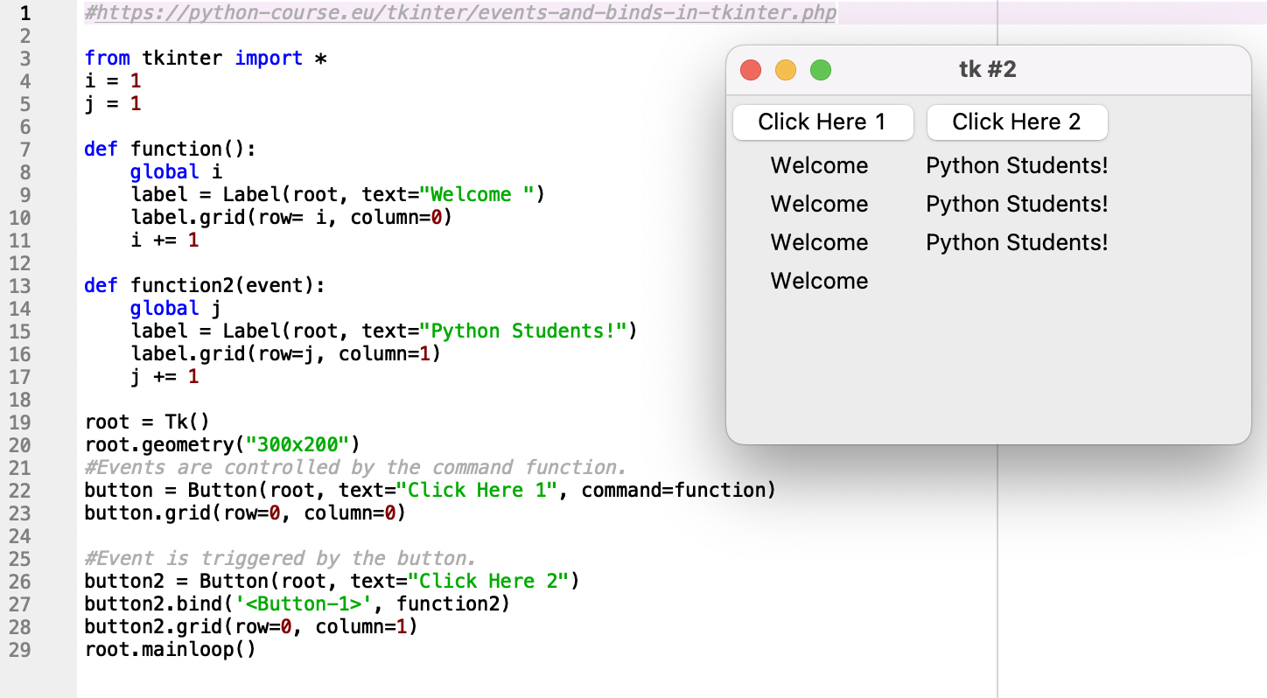
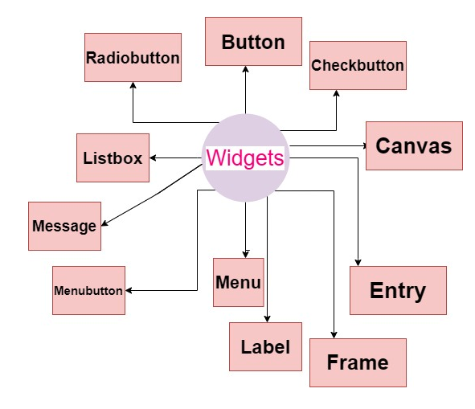
Event Handling
What is an event?

